Slide 1
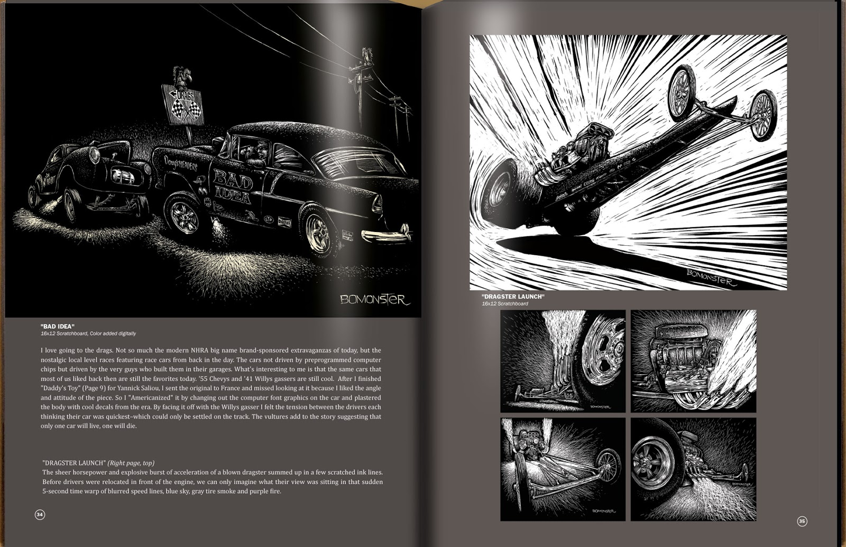
Scratch
Racing

Slide 2
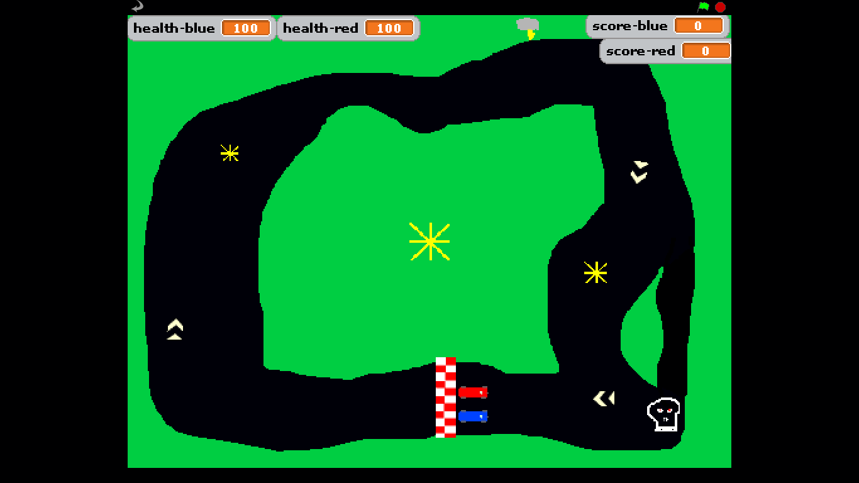
Overview
We will be creating a racing game in Scratch
It will be a top-down style game with a bird’s eye view
We can incorporate health, bonuses, traps, etc
It will be two player BUT you will make YOUR OWN!

Slide 3
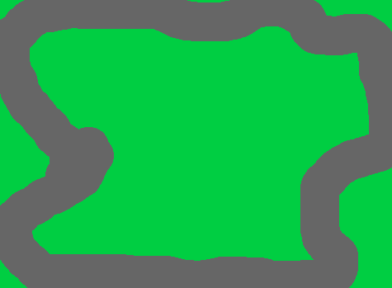
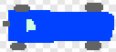
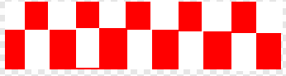

Create a racing track & cars
Use different colours for the track and the off-track area
We will use colour detection to slow the cars down when they go off-track
Add other embellishments if you have time
Create two car sprites
Remember – top-down view
Make the cars different colours
Give the sprites names
Create a starting line sprite
Do not draw the start line on your track
Avoid using the same colour as the track or off-track area for this

Slide 4
Movement
Add keys to get one car moving – arrow keys are good
Left and right are straight-forward

Slide 5
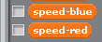

Movement continued
Accelerate and brake
Create two variables to tell the program how fast the cars move
Red-speed
Blue-speed
We do this using the Make a variable button in the Variables section

Slide 6

Movement continued
Add a forever loop
Add a move block
Use one of the speed variables you created in the move block

Slide 7
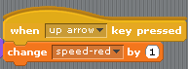
Movement continued
Now add some code to adjust the speed variable when accelerate and decelerate are pressed
Try playing the game now to make sure it works
If it doesn’t, troubleshoot your script

Slide 8
Scoring
Add a lap counter
This will need variables to keep track of laps for each car
When the start line is touching a car sprite, increase score

Slide 9
Hazards & Bonuses
Can you think of some hazards and bonuses to add to your track?

Slide 10
Peer Review
Swap chairs with someone and play their game
WWW
EBI

